Slide 1

Applied Statistical Analysis II POP77003
Charles Crowley
Replication Study

Slide 2


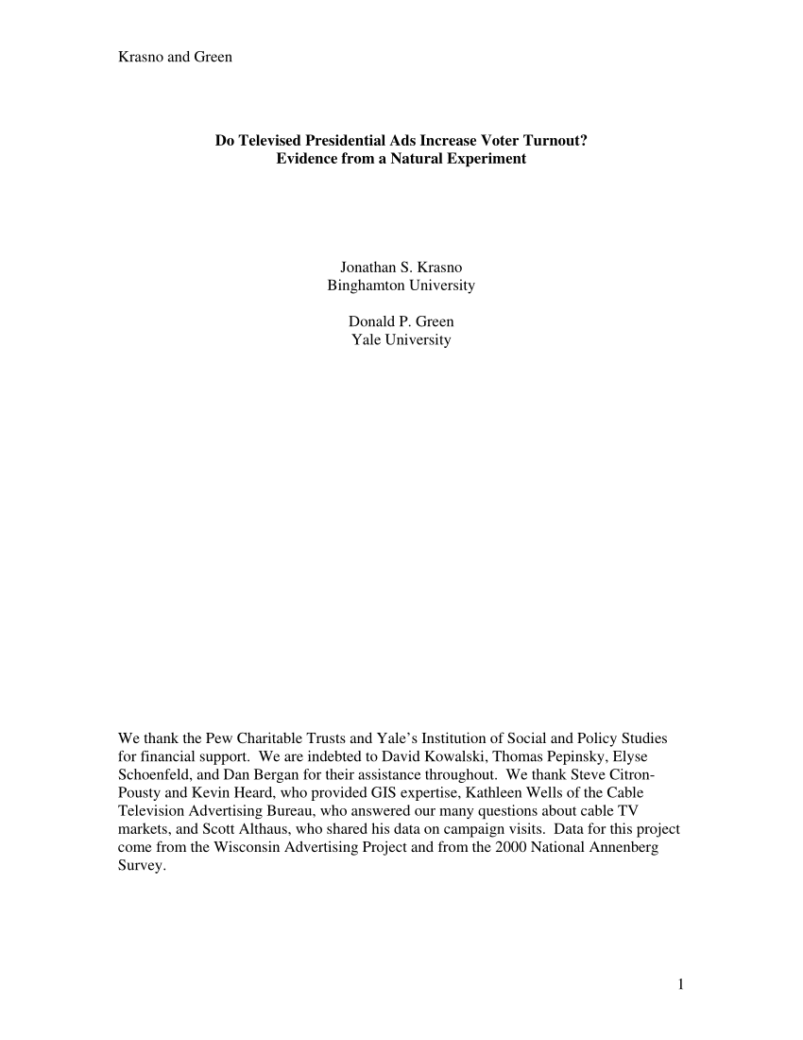
Do Televised Presidential Ads Increase Voter Turnout? Evidence from a Natural Experiment. Author(s): Jonathan S. Krasno and Donald P. Green Source: The Journal of Politics , Vol. 70, No. 1 (Jan., 2008)

Slide 3
Paper Overview
0riginal Paper
Study televised advertisements’ effect on voter turnout in the 2000 US presidential election. Over designated market areas (DMA) in “safe” and “battleground” states.
Q: To what extent, if any, is the mobilizing influence of presidential ads masked by variations in their tone? A: Classifying whether the tone of the ad is either positive or negative, they find no proof that attack ads promote or diminish turnout
Replication
Study televised advertisements’ effect on voter turnout in the 2008 US presidential election. Over designated market areas (DMA) in “safe” and “battleground” states.
Q: To what extent, if any, is the mobilizing influence of presidential ads masked by variations in their tone? A: In the replication with data from the 2008 presidential election, we find similar negligible results.

Slide 4
DATA
Original PAPER
2022 REPLICATION
- Because we investigate the differences between DMAs within states, we only include states with more than one DMA. This leaves us with 37 states and 150 DMAs.
- The dependent variable in Krasno & Green’s paper is the turnout rate in 2000, measured as the proportion of voting-age citizens who vote. Their voting data is from the America Votes series and population data is from the 1990 and 2000 censuses.
- The independent variable in our analysis is media exposure. To measure media exposure, Krasno & Green use Gross Rating Points (GRP) which is a measure of advertisement impact
-Senate and House election ads from the Wisconsin Advertising Project & candidate appearances as control variables. Turnout rates for the recent Senate elections (1990, 1994 & 1998) and presidential elections (1992 & 1996)
- I will also include DMAs that cross state borders. This means I will have 231 observations while Krasno & Green had 128 observations.
- The dependent variable in my replication is the turnout rate in 2008, measured as the proportion of voting-age citizens who vote. Voting data is from the America Votes series.
- The independent variable for this replication is total number of presidential advertisements. Unable to purchase GPR for 2008. The number of advertisements is from the American Media Freedom Project.
-Senate and House election ads from the Wisconsin Advertising Project & candidate appearances as control variables. Turnout rates for the recent Senate elections (2002 & 2006) and presidential elections (2000 & 2004).

Slide 5
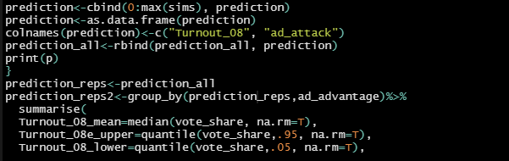

Model
Finding some evidence of heteroskedasticity, test using log of population and voting rate, we estimate our models using both OLS (with robust standard errors)
Linear regression felm() is used to fit linear models with multiple group fixed effects.
Re-estimate the model using tone variables provided in the dataset (ad_attack, ad_contrast, ad_promote). F-Test showed that the model’s fit were not significantly improved, as shown by high p values. Of the 3 ad_attack was the most likely to increase voter turnout.
$$Ti=b0+b1Xi+\sum_{2}^{j}{bjZij+ui}$$
Ti = voter turnout in media zone i
Xi = number of Presidential ads in zone i
Zij = dummy variables
ui = unobserved causes of voter turnout

Slide 6
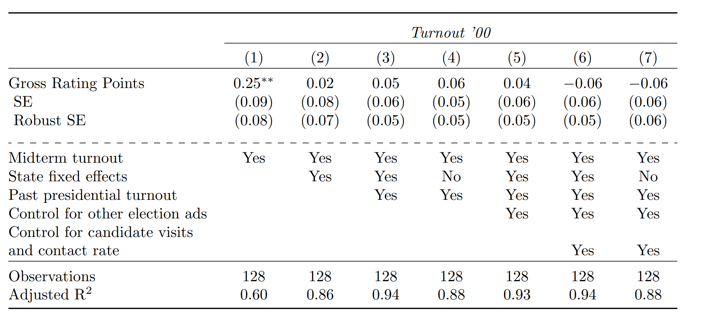
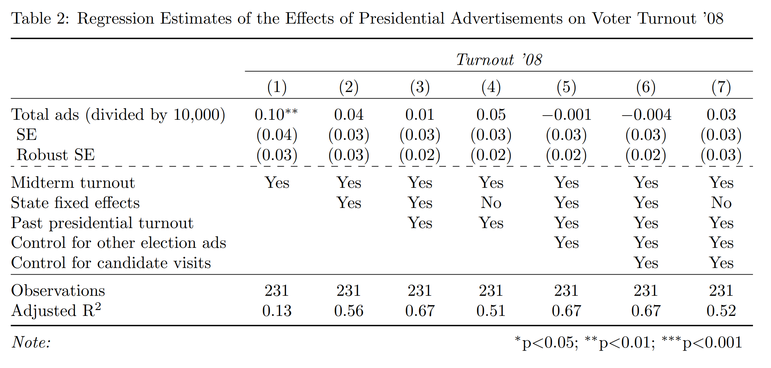
Output Comparison Model 1 reports a regression of media exposure on voter turnout including control for turnout in the recent midterm election. This model shows that ads in the final three weeks of the election had a statistically significant effect on turnout. An increase in total ads by 10,000 is associated with an increase in turnout by .1 percentage points. Note our R Squared is reduced when compared to the 2000 regression.

Slide 7
Findings
F-tests were conducted in order to ascertain whether allowing the three categories of ads tone have different coefficients significantly improved the fit of the models. In none of these cases were the statistical tests significant.
We find no effect of televised ads on voter turnout in 2000 nor in 2008. This strengthens the inferences we can draw because the conclusions are not just driven by one election.
Few observations increase the risk for multicollinearity. The unit of analysis includes 231 observations with 37 state dummy variables, leaving us with around six observations for each estimated, thus potentially undermining the independent variables significance.
Potential conflict in social media’s emergence and inability to determine which voter type is more affected by TV ads. Also, significant increase in voter turnout in 2008 (61.6% vs 54.2%)

